Slide 1

Facial IMAGE RECOGNITION
Team bengio:
Akshay Agarwal kannu priya arora vinod elangovan Gaurav girdhar
Pankaj mittal claude phan Sandeep Kataria

Slide 2
Data source: https://www.kaggle.com/c/challenges-in-representation-learning-facial-expression-recognition-challenge/data
Training data size
Methodology: 1. Histogram 2. Principal component analysis 3. linear classifer

Slide 3

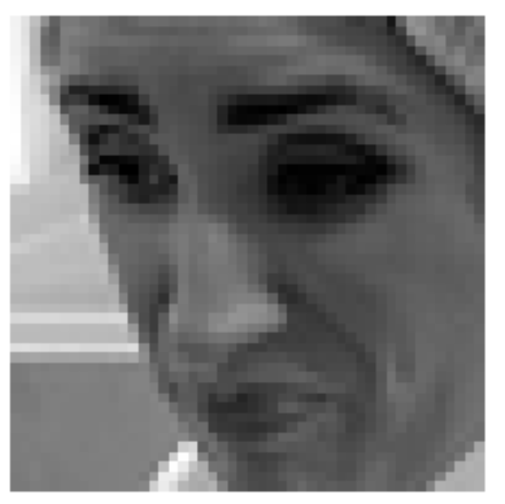
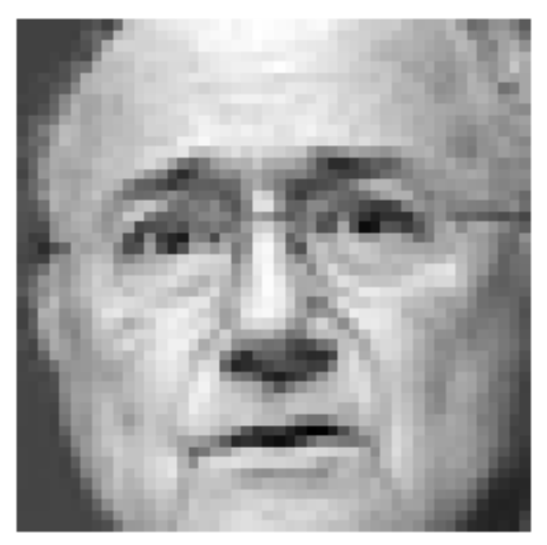
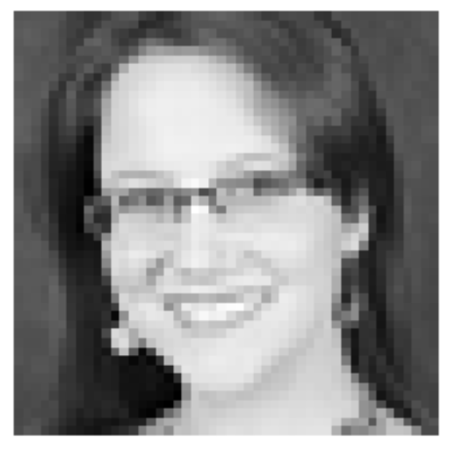
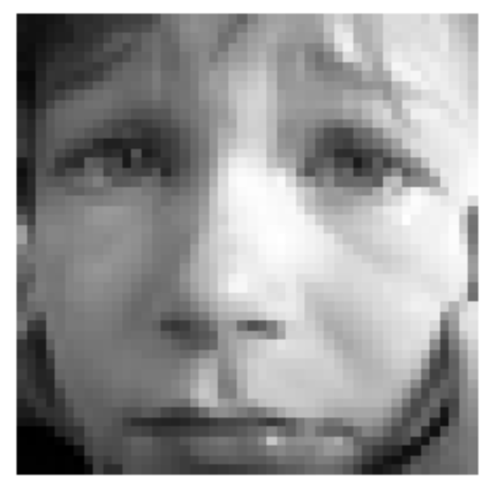

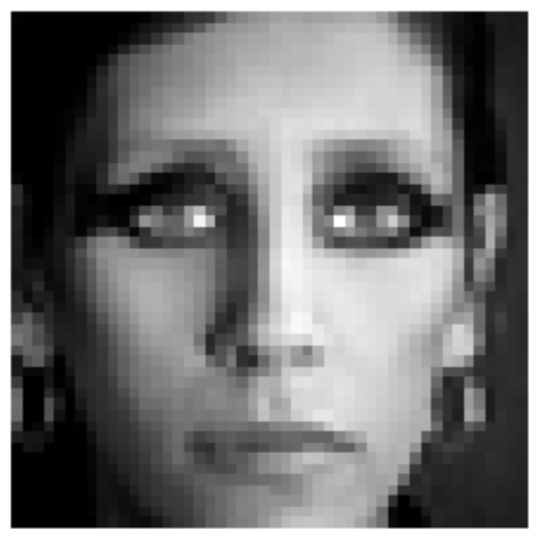
Classes: 0=Angry, 1=Disgust, 2=Fear, 3=Happy, 4=Sad, 5=Surprise, 6=Neutral

Slide 4
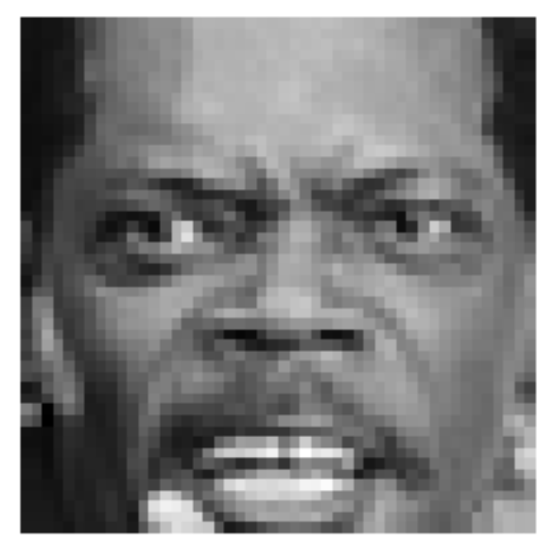
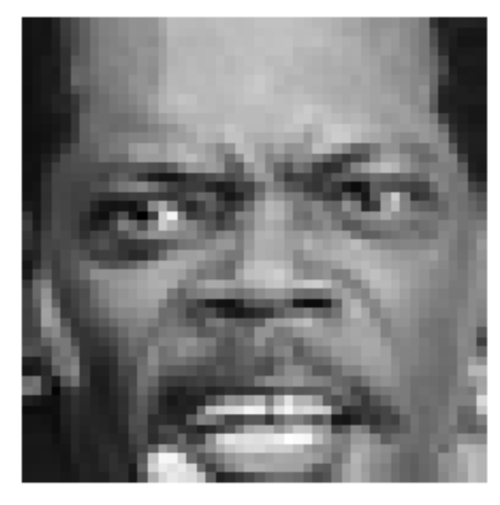
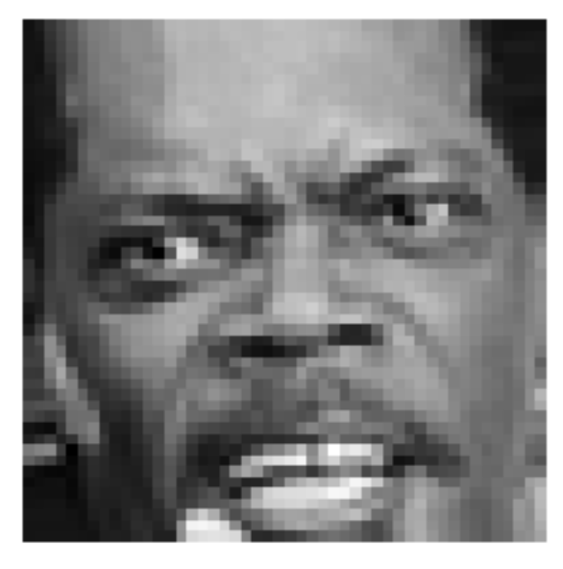
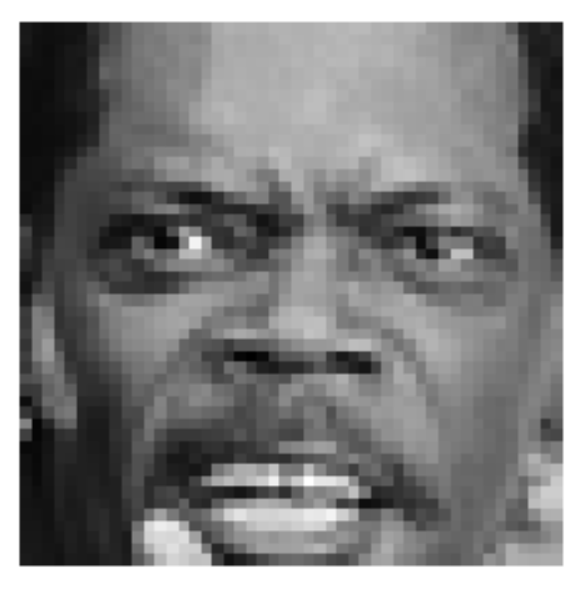
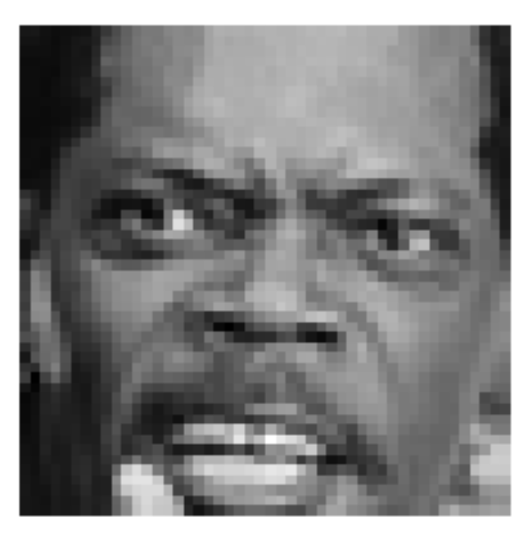
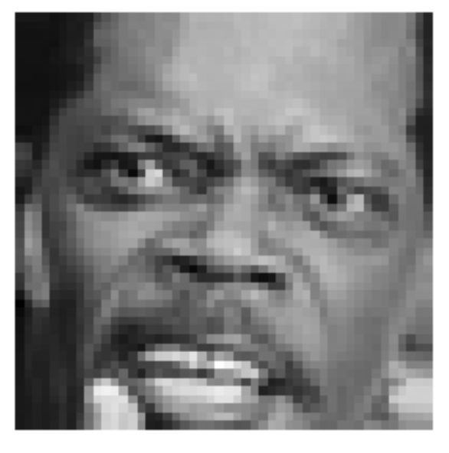
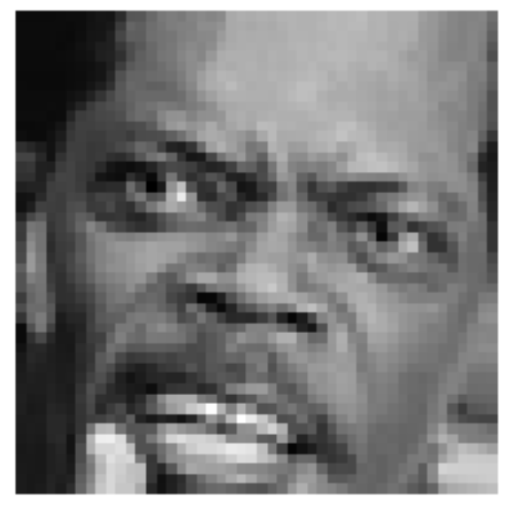
3 degrees
6 degrees
10 degrees
Left
Right

Slide 5
Histogram classifier results

Slide 6
Principal component analysis (original data set with class label data bias) results

Slide 7
Principal component analysis alternate (bias removed) results

Slide 8
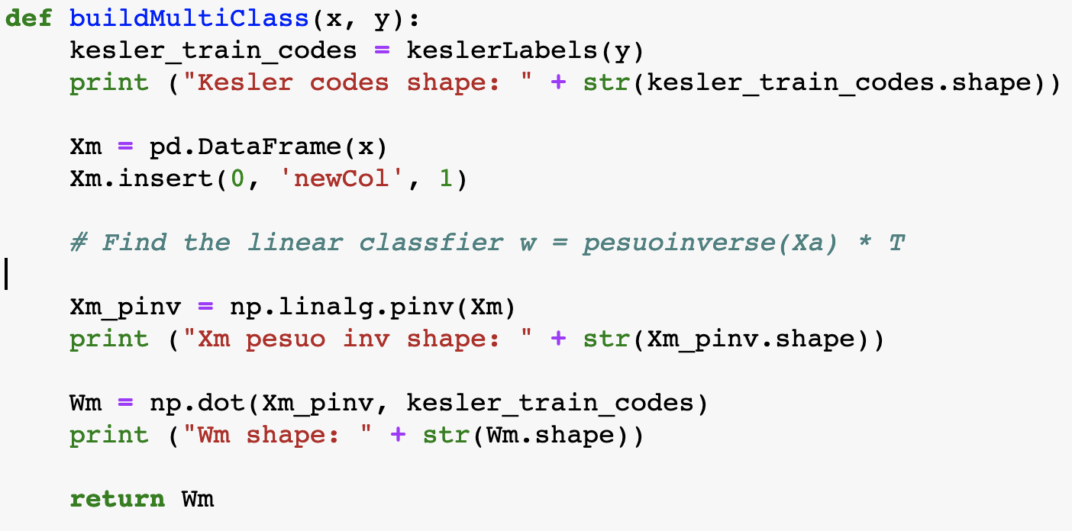
linear classifier
42% Accuracy on Test Data
37% Accuracy on Training Data
Using original dataset + 6 degree + 10 degree rotations
Attempted to use PCA, yet accuracy was much worse

